Slide 1

Java™ How to Program, 8/e
© 1992-2010 by Pearson Education, Inc. All Rights Reserved.

Slide 2

Syllabus, Laboratory, and Supporting Material.
Download example programs
  www.deitel.com/books/jhtp8/
  www.prenhall.com/deitel
See the Before You Begin section after the Preface
© 1992-2010 by Pearson Education, Inc. All Rights Reserved.

Slide 3

You’ll learn to write instructions commanding computers to perform tasks.
Software (i.e., the instructions you write) controls hardware (i.e., computers).
Java is one of today’s most popular languages for developing software.
© 1992-2010 by Pearson Education, Inc. All Rights Reserved.

Slide 4

A Computer System = hardware + software
Hardware--the physical computer
  e.g., keyboard, screen, mouse, disks, memory, DVD, CPU, etc.
Software--the applications that run on a computer.
  e.g., Word, iTunes, Chrome, etc.
So what is a computer?
© 1992-2010 by Pearson Education, Inc. All Rights Reserved.

Slide 5

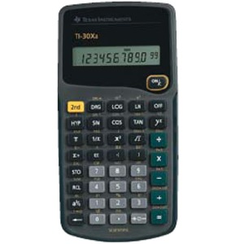
Computer—A device that can perform calculations and make logical decisions phenomenally faster than human beings can.
Let’s think about a handheld calculator as a simple example:
How do we interact with this thing?
Let’s get the square of the number 12:
  Provide input (type in 12)
  Choose an operation (press x² button)
  Ask for output (press the = button)
© 1992-2010 by Pearson Education, Inc. All Rights Reserved.

Slide 6
How about a slightly more complex example:
Let’s add the number 23 to our previous answer:
  Choose an operation (press + button)
  Provide some more input (type in 23)
  Notice: the calculator has REMEMBERED the output from the first operation (the square of 12 or 144) – it stores this in its memory
  Ask for output (press the = button)
© 1992-2010 by Pearson Education, Inc. All Rights Reserved.

Slide 7

But what is going on “under the hood” of your calculator?
MEMORY
INPUT
PROCESSOR
OUTPUT
© 1992-2010 by Pearson Education, Inc. All Rights Reserved.

Slide 8
Input (Keys): A part for supplying the needed information (Data)
Processor: The part that actually does the operation (Ex: square root, addition, etc.)
Memory: A part that stores data for later use
Output (Screen): A part that displays the results of the calculation.
© 1992-2010 by Pearson Education, Inc. All Rights Reserved.

Slide 9
Computer architecture is essentially the same, with only slightly more complication
MEMORY
MASS STORAGE
Main Memory
Hard Drive
INPUT
OUTPUT
Keyboard
Screen
PROCESSOR
Mouse
Printer
Control
Unit
ALU
Mic
Speakers
© 1992-2010 by Pearson Education, Inc. All Rights Reserved.

Slide 10
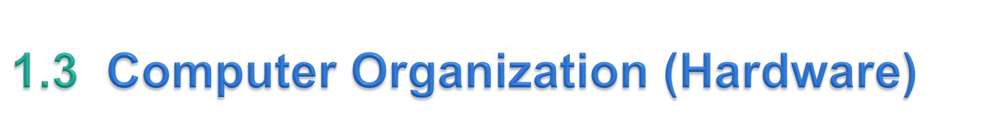
The elements that make up a modern computer can be divided into Logical (Conceptual) units, each performing a specific type of function.
  Input Unit
  Memory Unit
  Mass Storage Unit
  Arithmetic-Logic Unit (Part of the Processor)
  Control Unit (Part of the Processor)
  Output Unit
© 1992-2010 by Pearson Education, Inc. All Rights Reserved.

Slide 11
Input unit. This “receiving” section obtains information (data and computer programs) from input devices and places it at the disposal of the other units so that it can be processed.
Input devices
  Keyboard, mouse, microphone, scanner, hard drives, CD drives, DVD drives, USB drives and more
© 1992-2010 by Pearson Education, Inc. All Rights Reserved.

Slide 12
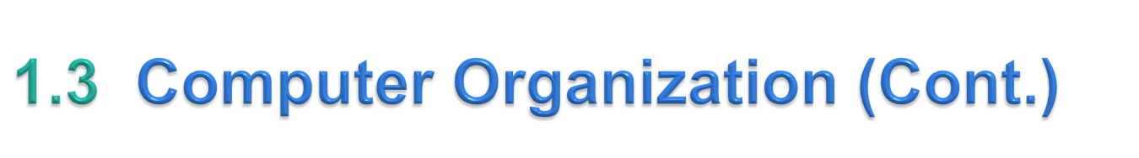
Memory unit
  Rapid-access, relatively low-capacity “warehouse” section retains information that has been entered through the input unit, making it immediately available for processing when needed.
  Retains processed information until it can be placed on output devices by the output unit.
  Information in the memory unit is volatile—it’s typically lost when the computer’s power is turned off.
  Often called either memory or main memory.
© 1992-2010 by Pearson Education, Inc. All Rights Reserved.

Slide 13
Mass storage unit
  Long-term, high-capacity “warehousing” section.
  Programs or data not actively being used by the other units normally are placed on secondary storage devices (e.g., your hard drive) until they are again needed, possibly hours, days, months or even years later.
  Information on secondary storage devices is persistent—it is preserved even when the computer’s power is turned off.
  Examples of secondary storage: CDs, DVDs and flash drives
© 1992-2010 by Pearson Education, Inc. All Rights Reserved.

Slide 14
Arithmetic and logic unit (ALU)
  “Manufacturing” section performs calculations, such as addition, subtraction, multiplication and division.
  Contains the mechanisms that allow the computer to make decisions.
  In today’s systems, the ALU is usually implemented as part of the central processing unit or CPU.
© 1992-2010 by Pearson Education, Inc. All Rights Reserved.

Slide 15
Control unit
  “Administrative” section coordinates and supervises the operation of the other sections.
  Tells the input unit when information should be read into the memory unit.
  Tells the ALU when information from the memory unit should be used in calculations and tells the output unit when to send information from the memory unit to certain output devices.
  In today’s systems, the control unit is usually implemented as part of the central processing unit or CPU.
© 1992-2010 by Pearson Education, Inc. All Rights Reserved.

Slide 16
Output unit. This “shipping” section takes information that the computer has processed and places it on various output devices to make it available for use outside the computer.
Output devices
  Screen, printer, speakers and more
© 1992-2010 by Pearson Education, Inc. All Rights Reserved.

Slide 17

We understand what a computer is, but how do we program one?
The calculator example was not really programming.
By analogy: the calculator example is like cooking a gumbo, but programming is like writing a recipe for gumbo, that somebody else (the computer) will follow later to actually do the cooking.
© 1992-2010 by Pearson Education, Inc. All Rights Reserved.

Slide 18
When we write a computer program we are making a list of step by step instructions, called source code.
Source code is written in a text editor and saved into a text file.
Source code must be translated from the Java programming language to the computer’s “machine language” (1’s and 0’s) before we can ask the machine to follow it.
Translating the source code is called compiling, it is done by an application called a compiler
© 1992-2010 by Pearson Education, Inc. All Rights Reserved.

Slide 19
A compiler takes as input a source code file (or source file) and produces instructions in the machine language called object code, which are saved into an object file.
These instructions will be followed by the computer later when we “run” the program.
When we double-click on the Chrome icon we are telling the computer to run the Chrome program
So what instructions can we give a computer?
© 1992-2010 by Pearson Education, Inc. All Rights Reserved.

Slide 20

Five Types of Instructions for Programming a Computer:
  Input and Output
  Storage
  Operations
  Control Structures
  Procedures (Methods or Functions)
© 1992-2010 by Pearson Education, Inc. All Rights Reserved.

Slide 21
Let’s look at an example recipe and see how it is like a computer program.
Gumbo Recipe:
  Chop celery, onions, bell peppers, and garlic
  Make a basic roux
  Put celery, onions, bell peppers, and garlic into work pot
  While the vegetables are still hard, keep stirring.
  If you are making a seafood gumbo, add in shrimp and crab, or else add in chicken and sausage.
  …
© 1992-2010 by Pearson Education, Inc. All Rights Reserved.

Slide 22
We have examples of each of the five basic types of commands
  Input and Output
    Input – the ingredients
    Output – the finished gumbo
  Storage – the containers we put the ingredients in
  Operations – chop, mix, stir, boil, etc.
  Control Structures
    while (repetition)
    if/else (selection)
  Procedures (Methods or Functions) – make a basic roux
© 1992-2010 by Pearson Education, Inc. All Rights Reserved.

Slide 23

Think of computer memory as being like shelves in a hardware store.
We can put containers on these shelves to store things like screws, bolts, or things like oil and silicone, etc.
We have a few standard types of containers we can use.
Each type of container is of a certain size and good for storing certain things.
© 1992-2010 by Pearson Education, Inc. All Rights Reserved.

Slide 24
For example we might have bins of three different sizes for storing screws, bolts, etc. And we might also have canisters in 5 gallon and 10 gallon sizes for storing liquids.
When we want to store something on the shelves we need to pick the right type of container given what we are storing and how much of it we are storing.
© 1992-2010 by Pearson Education, Inc. All Rights Reserved.

Slide 25
We will also have to put a label on the container so that we can find what we stored later.
We will then need to actual put the thing we want to store in the container.
Notice also, that what exactly is stored in the container changes over time. We might start with 50 screws and over time sell some, so that the container now has only 20.
© 1992-2010 by Pearson Education, Inc. All Rights Reserved.

Slide 26
With computers we are storing information like numbers or text, called data.
The data is put into containers called variables (since what is there can vary or change)
We use the term data type to describe the different types of containers.
Java has several predefined Data Types.
© 1992-2010 by Pearson Education, Inc. All Rights Reserved.

Slide 27
Just like the hardware store analogy, each data type is of a specific size and is good for holding a specific kind of data.
Standard number data types
  int – for integers that fit into 32-bits of memory
  long – for integers that fit into 64-bits of memory
  float – for real numbers (numbers with a decimal) that fit into 32-bits of memory
  double – for real numbers (numbers with a decimal) that fit into 64-bits of memory
© 1992-2010 by Pearson Education, Inc. All Rights Reserved.

Slide 28
Standard text data types
  char – for single characters like ‘a’ or ‘%’ or ‘;’
  String – for storing whole pieces of text like “Hello World”
Note that the number 2 and the character ‘2’ are different things to the computer. In the same way, the number 256 and the String “256” are also different to the computer.
© 1992-2010 by Pearson Education, Inc. All Rights Reserved.

Slide 29
We also have a data type called boolean, which is for storing true and false.
This may sound strange, but you will see later that it is very useful.
© 1992-2010 by Pearson Education, Inc. All Rights Reserved.

Slide 30
If we want to store the number 10, we need to tell the computer that we will be storing an integer, give that storage spot a name like “firstNumber” and then put the value in that storage spot like this:
  int firstNumber = 10;
© 1992-2010 by Pearson Education, Inc. All Rights Reserved.

Slide 31
Notice that we have specified the data type (int), the label or variable name (firstNumber) and assigned using the = the number 10 to it.
Notice also that it ends with a semicolon. Every instruction or statement in Java must end with a semicolon.
© 1992-2010 by Pearson Education, Inc. All Rights Reserved.

Slide 32
Variable Names:
  We need to give each variable we create a unique name.
  Variable names should always start with a letter
  The rest of the variable name can be any combination of letters, numbers, underscores (_), or dollar signs ($).
  Variable names are case-sensitive. So “Name” and “name” are two different variables.
© 1992-2010 by Pearson Education, Inc. All Rights Reserved.

Slide 33
We can create a variable without storing anything in it at first.
This is useful when you want to store the result of an operation, like the calculator example. For example:
  int secondNumber;
© 1992-2010 by Pearson Education, Inc. All Rights Reserved.

Slide 34

Just like a calculator, Java allows us to do operations on the data we have stored.
For numerical data (int, long, float, double) we have the standard operations:
  Add ( + ) : secondNumber = firstNumber + 2;
  Subtract ( - ): secondNumber = firstNumber – 4;
  Multiply ( * ): secondNumber = firstNumber * 3;
  Divide ( / ): secondNumber = firstNumber / 6;
© 1992-2010 by Pearson Education, Inc. All Rights Reserved.

Slide 35
We have to be careful when doing operations on data.
Each data type has its own version of each operation. Ex: 1 / 2 will result in zero.
But 1.0 / 2.0 will result in 0.5
Why?
The main thing to remember is that for each type of data, the computer performs the operations in a way that is specific to that type.
© 1992-2010 by Pearson Education, Inc. All Rights Reserved.

Slide 36
For text data types we have operations that are specific to text.
For example concatenation.
This is taking two strings of text and joining them together. Almost like addition for text:
The variable sentence now contains “Hello Dr. Summa"
  String greeting = “Hello “;
  String name = “Dr. Summa”;
  String sentence = greeting + name;
© 1992-2010 by Pearson Education, Inc. All Rights Reserved.

Slide 37

Java is an object-oriented (OO) language
Many basic tasks in Java can only be done using objects. We will cover this in detail later this semester.
For now think of objects as a piece of software you can use in your programs to do special tasks.
Also, objects look like data, they even have a type, similar to a data type.
© 1992-2010 by Pearson Education, Inc. All Rights Reserved.

Slide 38

When we get input we have to immediately store it into a variable.
To get input we need a type of object called a Scanner. We create it like this:
  Scanner input = new Scanner(System.in);
Don’t worry about understanding this for now.
© 1992-2010 by Pearson Education, Inc. All Rights Reserved.

Slide 39
Input Example: ‘Reading’ what a person types on the keyboard:
  String name = input.next();
Output Example: ‘Print” text to the computer screen:
  System.out.println(“Hello World”);
© 1992-2010 by Pearson Education, Inc. All Rights Reserved.

Slide 40

In Java we can include comments in out code.
Comments are not read by the computer, they are for humans to make notes and including explanations of what is going on in the code.
Single line comments begin with “//”
  Ex: // This is a simple comment
Multi-line comments begin with /* and end with */
© 1992-2010 by Pearson Education, Inc. All Rights Reserved.

Slide 41

Some “Boiler Plate Code”
  Like objects, we have not covered enough yet to explain this. Just know that you will have to type this in for every program you write.
/**
* Multi-Line comment
* Fall 2013
**/
public class ProgramName
{
public static void main( String[] args )
{
// your code goes here
}
}
© 1992-2010 by Pearson Education, Inc. All Rights Reserved.

Slide 42
Our first program, HelloWorld
Note: the program name must start with a capital letter, and the file name for the source file must be the program name,
  ex: HelloWorld.java
public class HelloWorld
{
public static void main( String[] args )
{
System.out.println( “Hello World” );
}
}
© 1992-2010 by Pearson Education, Inc. All Rights Reserved.
Notes:
Instructor switches to text editor, writes hello world program. Save, compile, and executes from the command line.

Slide 43
Using a variable.
public class HelloWorld
{
public static void main( String[] args )
{
// We declare a variable called greeting
String greeting = “Hello World”;
// And use it in the print statement
System.out.println( greeting );
}
}
© 1992-2010 by Pearson Education, Inc. All Rights Reserved.

Slide 44
Using input.
public class Addition
{
public static void main( String[] args )
{
//We initialize the Scanner object for getting input
Scanner input = new Scanner( System.in );
// We declare variables to store two integers and their sum
int firstNumber;
int secondNumber;
int sum;
// Use the print statement and Scanner to ask for and get input
System.out.println( “Enter the first number:” );
firstNumber = input.nextInt();
System.out.println( “Enter the second number:” );
secondNumber = input.nextInt();
sum = firstNumber + secondNumber;
System.out.println(“The sum is “);
System.out.println(sum);
}
}
© 1992-2010 by Pearson Education, Inc. All Rights Reserved.

Slide 45

Java programs consist of pieces called classes.
Classes include methods that perform tasks and return information when the tasks complete.
Java class libraries
  Rich collections of existing classes
  Also known as the Java APIs (Application Programming Interfaces)
Two aspects to learning the Java “world.”
  The Java language it-self
  The classes in the extensive Java class libraries
Download the Java API documentation
  java.sun.com/javase/downloads/
  Scroll down to the Additional Resources section and click the Download button to the right of Java SE 6 Documentation.
© 1992-2010 by Pearson Education, Inc. All Rights Reserved.

Slide 46
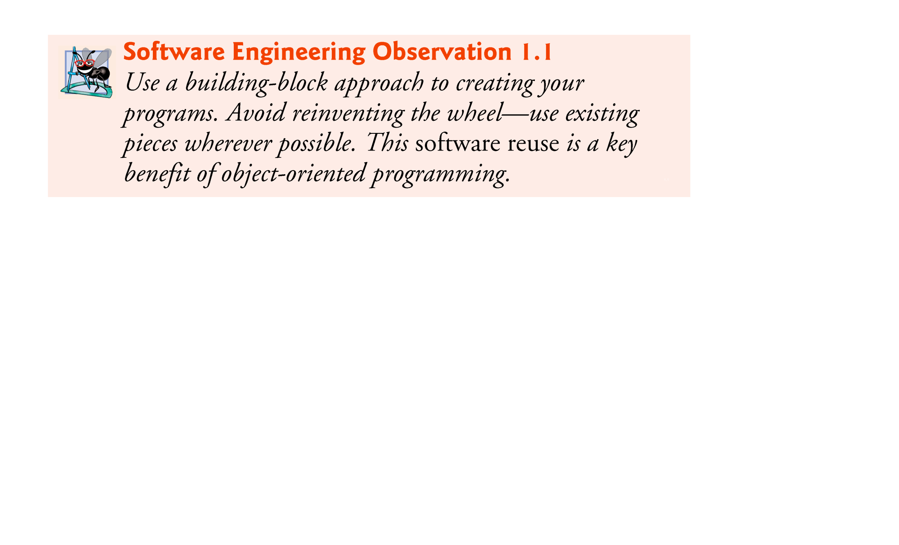
© 1992-2010 by Pearson Education, Inc. All Rights Reserved.

Slide 47
Programming tips
  Software Engineering Observations—explain concepts that affect and improve the overall architecture and quality of software systems.
  Good Programming Practices—help you write programs that are clearer, more understandable, more maintainable and easier to test and debug—i.e., remove programming errors.
  Common Programming Errors—discuss problems to watch out for and avoid.
© 1992-2010 by Pearson Education, Inc. All Rights Reserved.

Slide 48

Programming tips (cont.):
  Performance Tips—techniques for writing programs that run faster and use less memory
  Portability Tips—techniques to help you write programs that can run, with little or no modification, on a variety of computers
  Error-Prevention Tips—techniques for removing bugs from your programs
  Look-and-Feel Observations—techniques to help you design the “look” and “feel” of your applications’ user interfaces
© 1992-2010 by Pearson Education, Inc. All Rights Reserved.

Slide 49

A simple modified Hello World program
Start with the basic hello world code and add to it as needed.
See handout for instructions on installing the programs for your “programming environment”
© 1992-2010 by Pearson Education, Inc. All Rights Reserved.

